Slide 1
OPTICAL CHARACTER RECOGNITION
(OCR)

Slide 2
Contents
Definition
Introduction To OCR
Steps In OCR
Pre-Processing
Character Recognition
Post-processing
Sentiment Analysis
Applications
Uses
Conclusion

Slide 3
Definition
Optical Character Recognition (OCR) is the electronic conversion of images of typewritten or printed text into machine-encoded text.

Slide 4
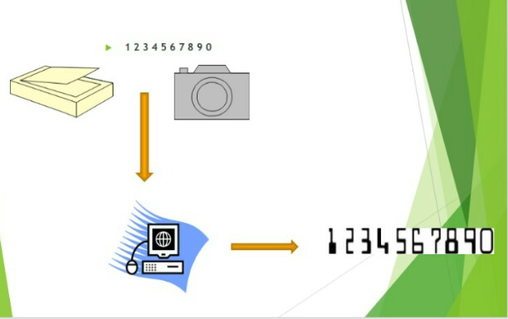
Introduction To OCR

Slide 5
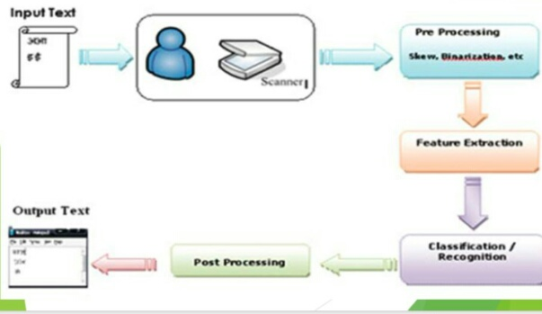
Steps In OCR

Slide 6
Pre-Processing
Deals with Improving quality of the Image for better recognition by the system. OCR software often "pre-processes" images to improve the chances of successful recognition.

Slide 7
Techniques include:
• De-Skew
• Despeckle
• Binarization

Slide 8
Character Recognition
There are two basic types of core OCR algorithm, which may produce a ranked list of candidate characters.
• Matrix matching involves comparing an image to a stored glyph on a pixel-by-pixel basis; it is also known as “pattern matching”. This relies on the input glyph being correctly isolated from the rest of the image, and on the stored glyph being in a similar font and at the same scale. This technique works best with typewritten text and does not work well when new fonts are encountered.

Slide 9
Feature Extraction serves two purposes; one is to extract properties that can identify a character uniquely. Second is to extract properties that can differentiate between similar characters.

Slide 10
Post-Processing
Tesseract uses its dictionary to influence the character segmentation step, for improved accuracy.

Slide 11
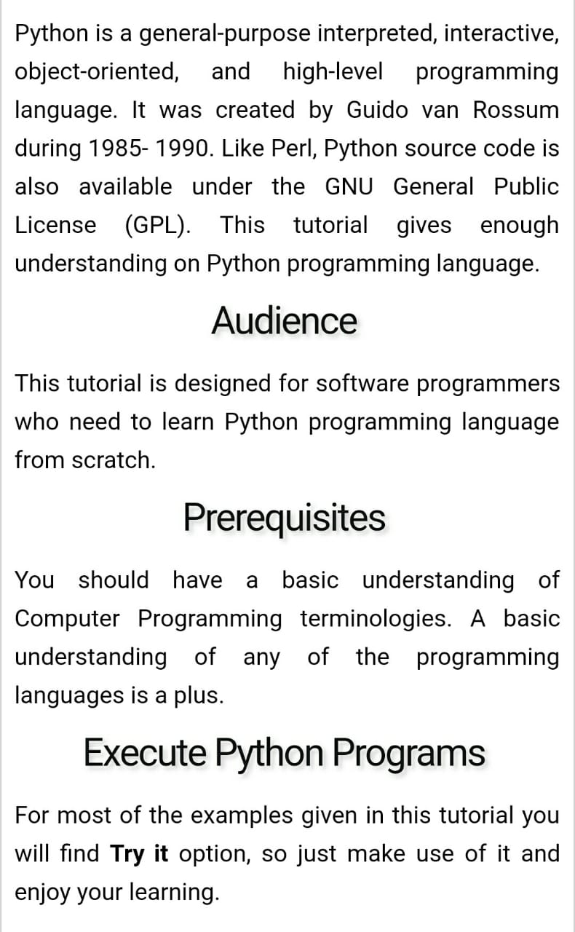
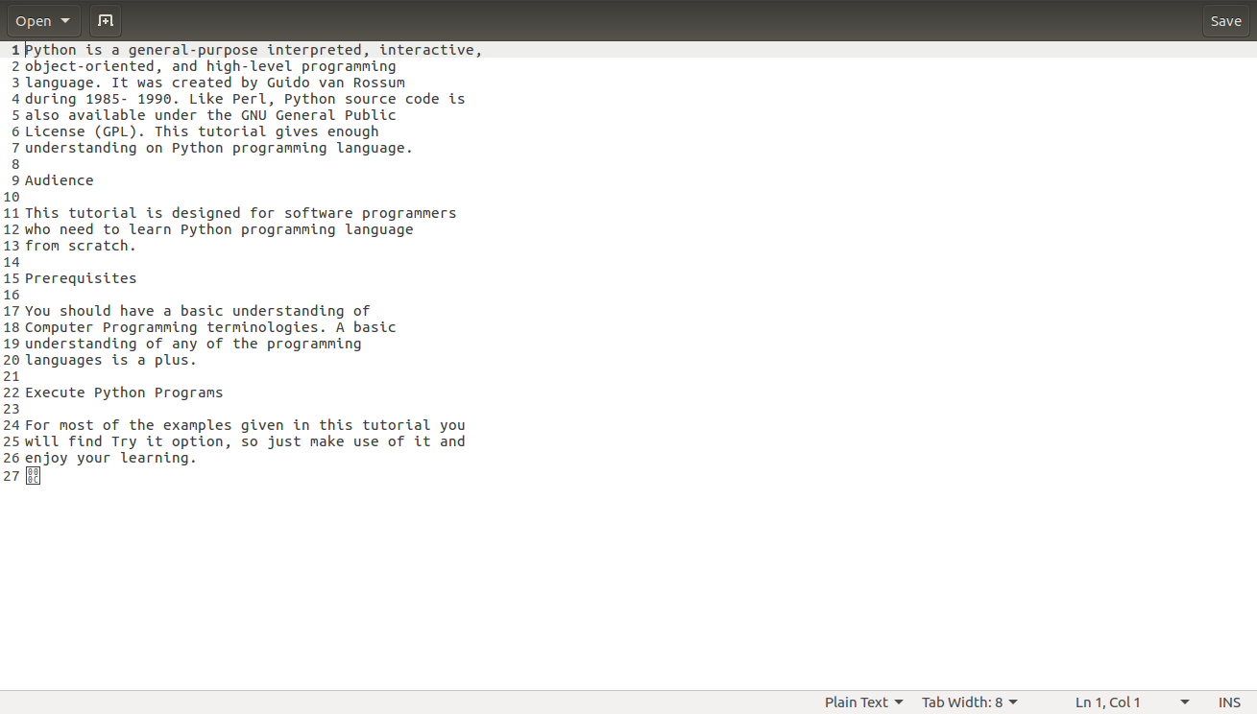
INPUT OUTPUT

Slide 12
Sentiment Analysis
The process of computationally identifying and categorizing opinions expressed in a paragraph, especially in order to determine whether what the writer want to convey about a particular topic.

Slide 13
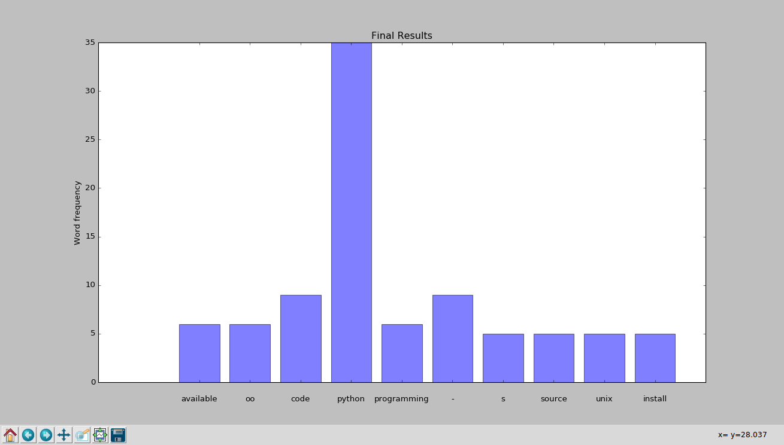

Slide 14
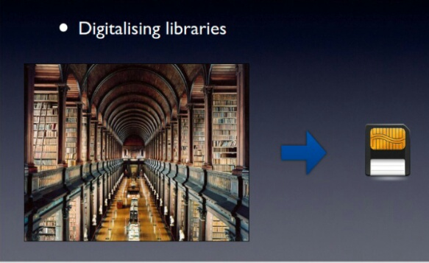
Applications

Slide 15
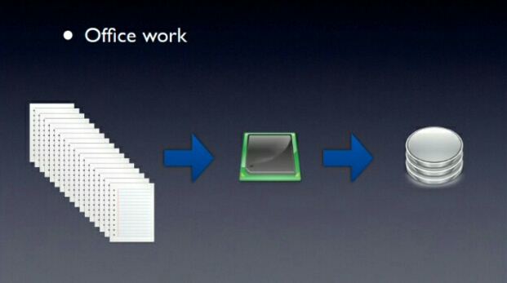

Slide 16
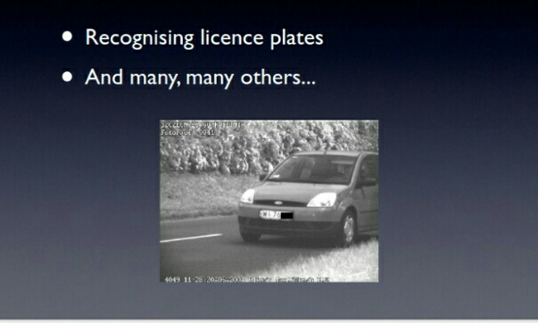

Slide 17
Uses
It is widely used as a form of Data Entry from Printed Paper data records, whether Passport Documents, Invoices, Bank Statements, Business Card, Mail or Other Documents.
It is common method of Digitizing Printed Texts so that it can be Electronically edited, searched, stored more compactly, displayed on-line, and used in Machine Processes such as Machine Translation, Text-to-Speech,Key Data and Text Mining.

Slide 18
Conclusion
OCR technology provides fast, automated data capture which can save considerable time and labour costs of organisations.
The system has its advantages such as Automation of mundane tasks, Less Time Complexity, Very Small Database and High Adaptability to untrained inputs with only a small number of features to calculate.

